Slide 1
Unshackle Your Database: Pragmatic SQL for .NET Developers
Joseph Daigle
Principal Software Engineer
Email: joseph.daigle@gmail.com
Twitter: @JosephDaigle
Web: josephdaigle.me
https://www.qgenda.com/
Notes:
A little about myself:
I’ve been a software developer for over 10 years, almost entirely .NET.
A little bit of consulting, but mostly working for B2B software product companies
Some desktop, but mostly web. And these days a lot of mobile API development.

Slide 2



Platinum Sponsors

Slide 3



Gold Sponsors

Slide 4
Silver Sponsors

Slide 5


After Party – Dave & Busters
2215 D&B Drive Southeast Marietta, GA
Sponsored By:

Slide 6
What are we talking about today?
Motivation and why this matters
Deconstructing the general purpose ORM
Analyzing performance, maintainability, correctness
Introducing Micro ORMs
Notes:
We’re going to be talking about data.
The Object Relational Mapper is the most common tool in a developer’s toolbox for working with relational data
Take the ORM that we have a love/hate relationship with and deconstruct it.

Slide 7
What motivates me?
Data is king, the database is the kingdom
Performance is a feature
Correctness and maintainability trump fancy and new
Performance is a feature
Notes:
I’m a server-side guy.
Data is something that I’ve very passionate about. Most of the applications you or I work on are heavily data driven
As a junior, fell into the mindset of treating persistence as just “object storage”. But in reality the database will outlive the application
And performance is a killer feature
I don’t always by into the latest hype – starting to the exit the phase where things like NoSQL were touted as the silver bullet, people are realizing that relational database are really good when used appropriately and to their fullest potential
When building software, I like to think of myself like Ricky Bobby: I want to go fast.

Slide 8
Why should I care?
Performance
Correctness
Maintainability
Notes:
Why should you care?
Three key themes:
* Performance, Correctness, and Maintainability will be key themes throughout this talk

Slide 9
Why should I care?
User
Web Server
Database
Notes:
Before I jump into things, I want to talk a little bit about the "average" B2B Web Application
Most of the time we’re just getting data from the database and turning it into text, whether that’s HTML or XML/JSON or whatever.
For straight queries, very few business rules. Optimize that pipeline.
SLA Matters (e.g. under 200ms at the server)

Slide 10
Why should I care?
In House LOB
Successful B2B Startup
Stack Overflow
Salesforce
Google
10s
of Users
10,000s
of Users
1,000,000s of Users
100,000,000s of Users
Performance Sensitive
Notes:
Slide scale in terms of users, request per second
Gray area/tipping point where it becomes less and less feasible to just throw money/hardware at the problem – must look at fundenmentals

Slide 11
Object Relational Mappers
Notes:
* Let’s talk about ORMs.
I suspect nearly everyone in this room uses on a regular basis.
As a dev, it is the primary way to interact with any type of relational data store
They are really powerful and can do a lot. But let’s actually break them down.

Slide 12
Why do we use ORMs?
Help to solve the “object-relational impedance mismatch”
Often the primary interface developers have to a relational database
Avoid hand-writing SQL
Notes:
Impedance mismatch: differing concepts of data types, relationships, inheritance and polymorphism
Primary interface:
No SQL:

Slide 13
“General purpose” ORMs
Entity Framework 6
Nhibernate
LINQ to SQL
LLBLGen
Notes:
* I’m using a term “general purpose” to represent a certain class of ORM that contain a lot of useful feature for developers.
* These are often large and complex frameworks that can take years to fully master.
Written by experts.
For .NET developers, you may be familiar with these. Especially EF since it’s from Microsoft and used throughout their tutorials and guides.
But it’s useful to understand some of the core components that make up a general purpose ORM

Slide 14
Parts of an “General purpose” ORM
Object Mapper
Notes:
* Object Mapper

Slide 15
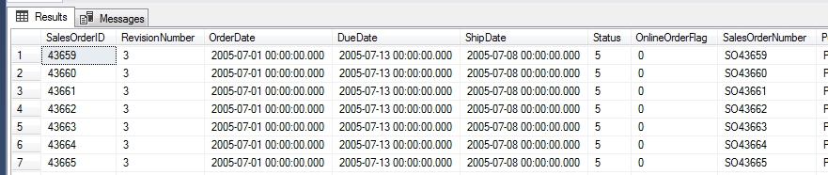
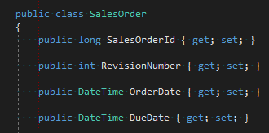
Object Mapper
Notes:
This is main reason we have ORMs – in fact it’s in the name.
Map database command results to objects. Tuples to classes.
Often implemented by generating or “compiling” a mapper a runtime – leads to slow startup times.
Complex ORM allow for complex mapping other than simple 1-to-1.
Outside of the actual database query (running on the database server), usually the biggest performance bottleneck

Slide 16
Parts of an “General purpose” ORM
Object Mapper
Query Generator
Notes:
* Query Generator

Slide 17
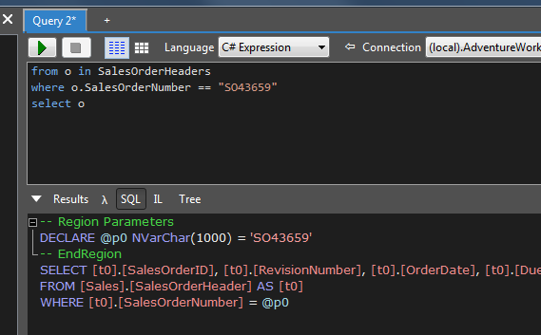
Query Generator
https://www.linqpad.net
Notes:
Generate SQL statements from the model and some DSL
For .NET devs today that’s usually LINQ
Other frameworks like Nhibernate and LLBLGen have custom DSL that’s, ironically, more expressive (we’ll get into this a little bit later)
BTW, you chould checkout linqpad

Slide 18
Parts of an “General purpose” ORM
Object Mapper
Query Generator
Identity Map
Notes:
* Identity Map
* Maintains first level “cache” of materialized entities by identity or key
* Not much else to talk about here

Slide 19
Parts of an “General purpose” ORM
Object Mapper
Query Generator
Identity Map
Unit of Work
Notes:
* Unit of Work

Slide 20
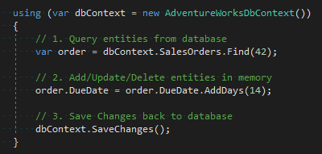
Unit of Work
Read entities from database
Modify entities (Add, Update, Delete)
Write changes back to database
Notes:
Basically implements change tracking within the ORM
Often used by scoping to a session or context
Generates appropriate SQL commands (INSERT/UPDATE/DELETE)
Attempts to determine optimal order based on FK constraints – some frameworks are better than others.

Slide 21
Data access performance
Notes:
Let’s now talk about how these components affect the performance of our data access layer
The examples about to show are written specifically for Entity Framework. Why? It’s probably the most used, and perhaps abused, ORM for .NET developers.

Slide 22
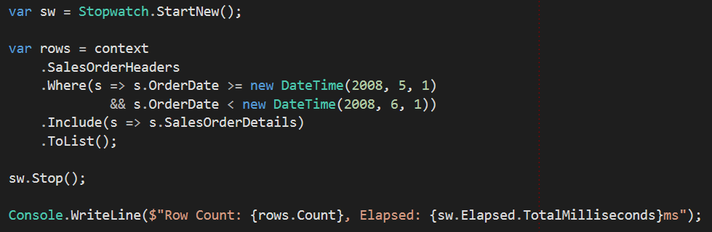
Materialization Benchmarks - Baseline
Notes:
This is a sterotypical database query using EF and LINQ.
Purposefully picked a simple query that should execute quickly inside the database, but one that will match to 1000s of rows.
I really want to focus here on the query pipeline inside our application.
Imagine we’re running a sales report for a month. Querying Sales Orders, but including it’s details. EF will generate a LEFT OUTER JOIN.
2386 Sales Orders returned. But if each have on average 10 SalesOrderDetails, that’s 23,860 database rows! In total over 25,000 object instances created.
That’s a lot of CPU cycles, and a lot of memory consumed. The elapsed time is what it happened to be on my computer.

Slide 23
Materialization Benchmarks - Baseline

Slide 24
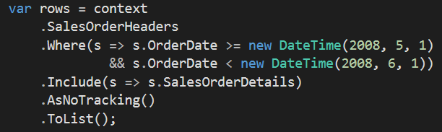
Materialization Benchmarks – NoTracking
Notes:
What happens if we tell the ORM to bypass the Identity Map?
EF “NoTracking” option.
Still returns 23,000 rows, still creates 25,000 objects.
But we’re not having to track and maintain state for each object.

Slide 25
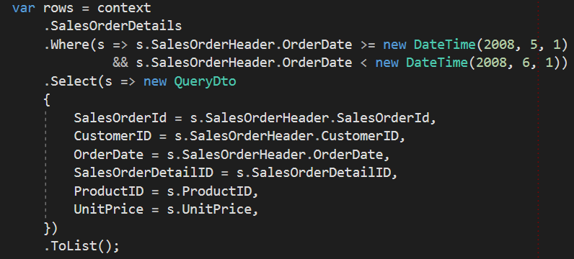
Materialization Benchmarks – Projection
Notes:
What if we flatten the query?
Using projection API, we’ll instruct EF to generate a query that only returns specific columns.
Instead of big entities, we’re going to return a smaller DTO (data transfer object) only contain properties we need for our report
Obviously not tracked

Slide 26
Optimize your query pipeline
Understand your use cases
Most queries in web applications just pull from the database and render to to text
Return flat/untracked DTO whenever possible instead of mapped entities
Only select the data you need (i.e. use projections)
Notes:
Key take aways
* Note that I’m not really talking about commands or transaction that result in data being written back to the database

Slide 27
When LINQ fails
Notes:
So far we’ve been talking about executing queries in the ORM’s query generator.
DSL’s like LINQ are wonderful tools in the developer’s toolbox.
But like a lot of tools in real life, if you don’t use it correctly you hurt yourself or others.

Slide 28
The LINQ handicap
LINQ expression must be parsed and compiled at runtime into a “plan” that generates SQL
Expensive, but cached
Some gotcha’s that will prevent your query from being cached
Expressions with .Contains() or certain types of functions that generate constant values
You can shoot yourself in the foot with LINQ
E.g. String or IEnumerable functions that produce inefficient or dangerous SQL
You can’t express everything available from SQL in LINQ
In ORM is black box
Notes:
LINQ applies a certain handicap to our ability to effectively write queries against the database.
It must be compiled. But it’s cached.
But the cache can fail.
Story of a LINQ expression that involved JOIN a dozen entities with a complex WHERE clause that consistently took over a second to parse and generate SQL even on production hardware. And it wasn’t cached.
Just because you can write a LINQ expression, doesn’t mean it’s a good idea
String and enumerable functions (IsNullOrEmpty, StartsWith, Contains) - generates SQL that can't utilize indexes
A lot of SQL functions are not available. Such as certain types of aggregation or window functions. The JOIN syntax is extremely limited – and anyone who has tried using it explicitly knows that it is clumsy at best.
Generally at best you can just hope that it will produce something efficient

Slide 29
Peeking inside the black box
Learn how to use query profilers
SQL Server Profiler
https://www.ormprofiler.com/
https://www.hibernatingrhinos.com/products/efprof
https://miniprofiler.com/
Learn about SQL Server internals
Indexing
Tuning
Locks and waits
Notes:
MSSQL ships with a profiler for free
Some commercial ones built for profiling from the application. Some designed to work with any ORM, some designed for specific ORMs. And there are some open source profilers available - do your homework.
Learn about SQL Server Internals. Learn how query performnce is impacting by indexing. How to tune indexes and queries. Understand locking and SQL Server waits. All incredibly useful skills.

Slide 30
Sometimes you just need to write SQL
Notes:
At the end of the day, sometimes you just need to write SQL

Slide 31
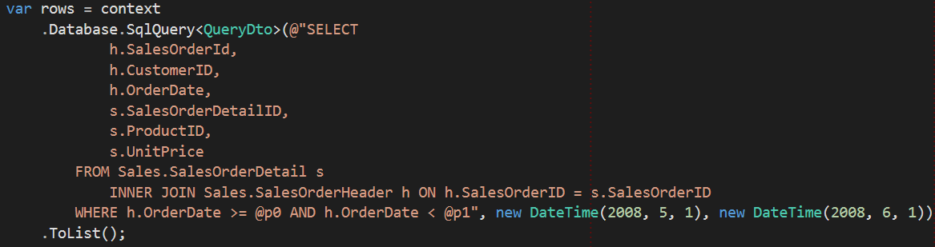
Materialization Benchmarks – SqlQuery
Notes:
Almost all ORMs like EF provide an API to drop down to raw SQL.
Same query as before. But now using SQL.
It’s also pretty much just as fast.

Slide 32
Enter micro ORM
Notes:
This brings us to Micro ORMs

Slide 33
Micro ORMs
Popped up onto the scene with bigger ORMs were perceived as “slow” or “bloated”
Usually only implement one or two big features (e.g. Object Mapper)
Often focus on raw SQL
Not a panacea
Notes:
Designed for that optimal query pipeline

Slide 34
Which to use?
Use a full-featured ORM:
Small applications where performance is nonessential
Executing business transactions with complicated rules or complex entity relationships
Use a Micro ORM:
Where performance is critical
When business logic is trivial or non-existent
Notes:
1. EF Great for small applications where you can get away with slow or inefficient queries
2.
3. Identity Map and Unit of Work are really useful when executing business transactions.
4.
Not mutually exclusive, many applications will use both.

Slide 35
Micro ORM Comparison
https://github.com/StackExchange/Dapper
https://github.com/FransBouma/Massive
https://github.com/CollaboratingPlatypus/PetaPoco
https://github.com/ServiceStack/ServiceStack.OrmLite
https://github.com/schotime/NPoco
Notes:
* Lot’s to choose from, different features, do your homework.

Slide 36
Dapper
For when you need to go really fast

Slide 37
What is Dapper?
Open source object mapper for .NET
Originally developed at Stack Overflow
Incredibly simple: just a few extension methods for IDbConnection
The most popular (judging by downloads, content available online, and of course posts on stackover)
Notes:
* At stack overflow
* Originally used LINQ to SQL, recognized that it wasn't scaling with their needs
Recognized that raw SQL was almost always more efficient
Built wrapper methods around lower level data access APIs in .NET
Eventually abstracted into a small library of extension methods

Slide 38
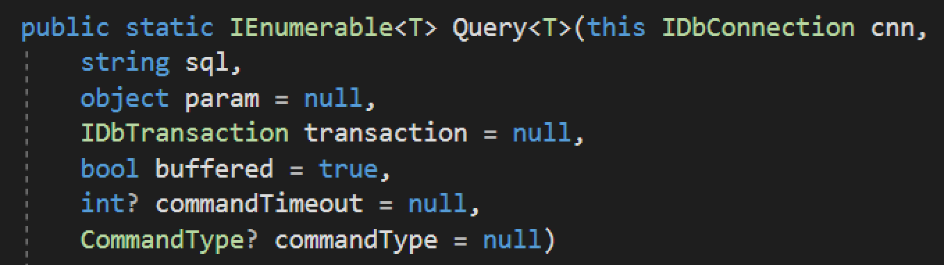
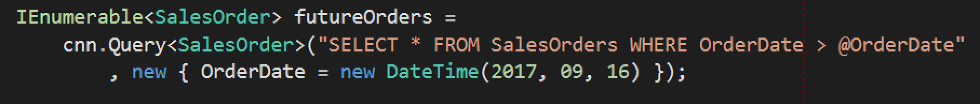
Execute a query and map the results to a strongly typed List
Notes:
Here is an example of one such extension method.
All you need is an IDbConnection and some SQL string. Dapper does the rest.

Slide 39
Execute a query and map the results to a strongly typed List
Automatically maps response to classes 1-1 by property name
Generates and caching a very fast object mapper
Promotes safe queries with easy parameterization
Parameters are passed as objects, and mapped by name
Notes:
A few things that I want to point
The DTO is an exact match based on property name and type
Parameters object can be of any type, even and anonymous type. Property names of parameters object map to parameter names in SQL query. Could be a class or anon type
Aggressive caching and reuse – minor hit on first execution, then lightning fast thereafter

Slide 40
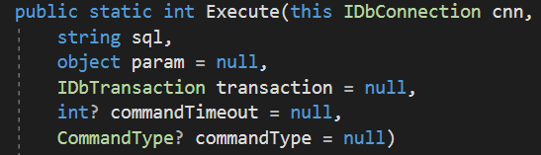
Execute a Command that returns no results
Notes:
Another extension method. To execute commands that don’t return results.

Slide 41
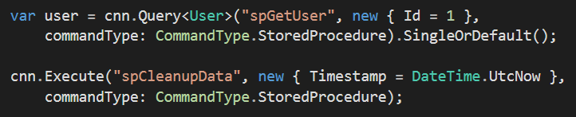
Stored procedures

Slide 42
Other features
List support (WHERE … IN (@p1, @p2,…))
Multiple result sets
Multi Mapping
Ansi Strings and varchar
And more (dynamic, tuples, literals, etc)
Notes:
* List support =

Slide 43
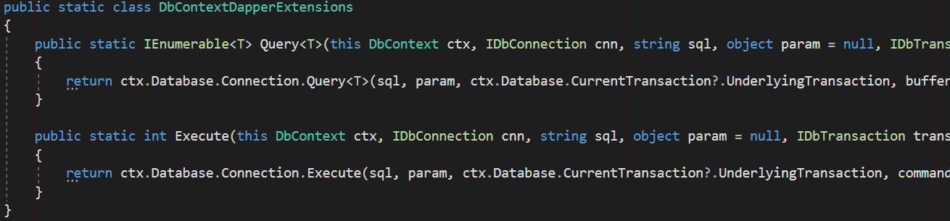
Using Dapper with Entity Framework
All you need is DbConnection (and DbTransaction)
DbContext.Database.Connection
DbContext.Database.CurrentTransaction.UnderlyingTransaction
Consider building your own wrapper extension methods

Slide 44
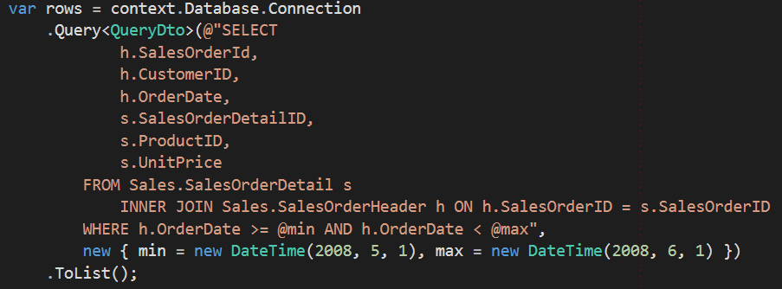
Materialization Benchmarks – Dapper

Slide 45
Where do I put all of this SQL?
Application code vs. stored procedures?
It’s not about performance. Stored procedures are not inherently more performant than properly parameterized ad-hoc statements
It’s about deployment. How will you manage and code changes?
Code that changes together should live together (high cohesion)
V₀
V₁
V₂
V₀
V₁
V₂
Notes:
Modern versus of SQL Server will optimize at the statement level. This means that individual statements or queries within a batch will receive the same type of optimization that occurs with a stored procedure.
Deployment is the primary concern
Consider a SaaS application that must be upgraded with nearly zero downtime
If using sprocs, how do we change the sproc without introducing breaking changes?
We always deploy our database changes before the app server changes. That means we database changes must be backwards compatible.
We’d have to introduce a different sproc.
If using application code, just change the application code and deploy.

Slide 46
Where do I put all of this SQL?
Stuck in bureaucratic prison that forces anything touching the database to go through a change control board?
I’m truly sorry
We’re hiring! (see me after the talk)

Slide 47
Wrapping it up
Performance
Correctness
Maintainability
Learn about the tools available to you
Choose the right tool for the job
Notes:
Remember our key themes

Slide 48
Questions?
Joseph Daigle
Principal Software Engineer
Email: joseph.daigle@gmail.com
Twitter: @JosephDaigle
Web: josephdaigle.me
Notes:
Thank you!

